Slide 1

Machine Learning-Based Prediction of Medical Appointment No-Shows
Team: leet hackerz — Members: ATTANA, JAYASREE

Slide 2

Introduction
Missed appointments consume clinical time, disrupt schedules, and increase operational cost. Machine learning (ML) can flag patients at high risk of no-shows so staff can intervene proactively with targeted reminders, rescheduling offers, or outreach.

Slide 3
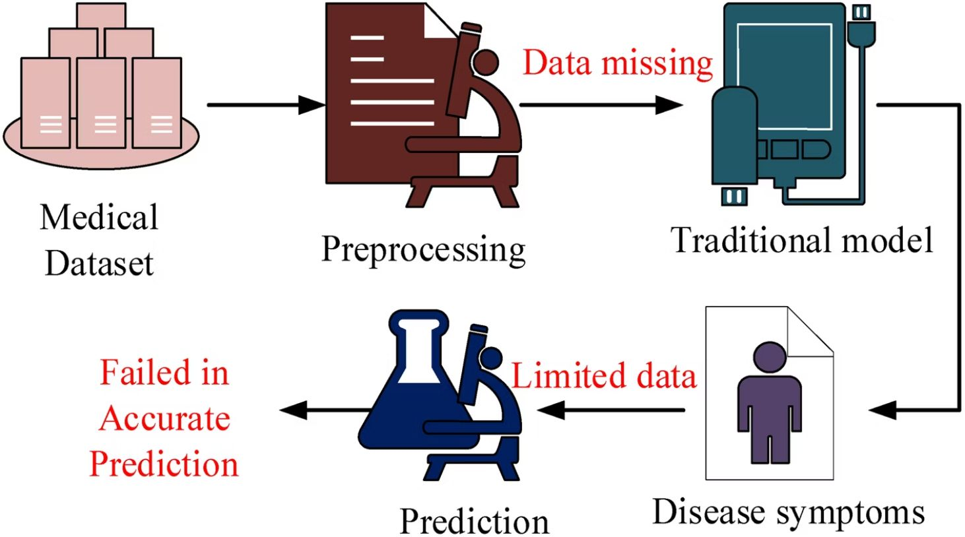
Problem Statement
Goal: Predict whether a patient will attend or miss a scheduled appointment.
Key challenge: Accurately identifying which patient- and appointment-level factors increase no-show risk while minimizing false alarms that waste staff time.

Slide 4
Objectives
Predict no-shows
Analyze data
Identify drivers
Develop models to score risk before appointment day.
Explore patient demographics, scheduling, and engagement signals.
Surface the strongest predictive factors for operational decision-making.
Improve workflows
Integrate predictions into reminders and scheduling to reduce waste.

Slide 5

Dataset — Features & Target
Features examined: Age, Gender, Appointment date and time, Waiting time between booking and visit, SMS/email reminders sent, Number of previous appointments and no-shows, Key health conditions / comorbidities, Insurance / socioeconomic proxies, Appointment type (telehealth vs in-person).
Target: Show vs No-Show (binary label).

Slide 6
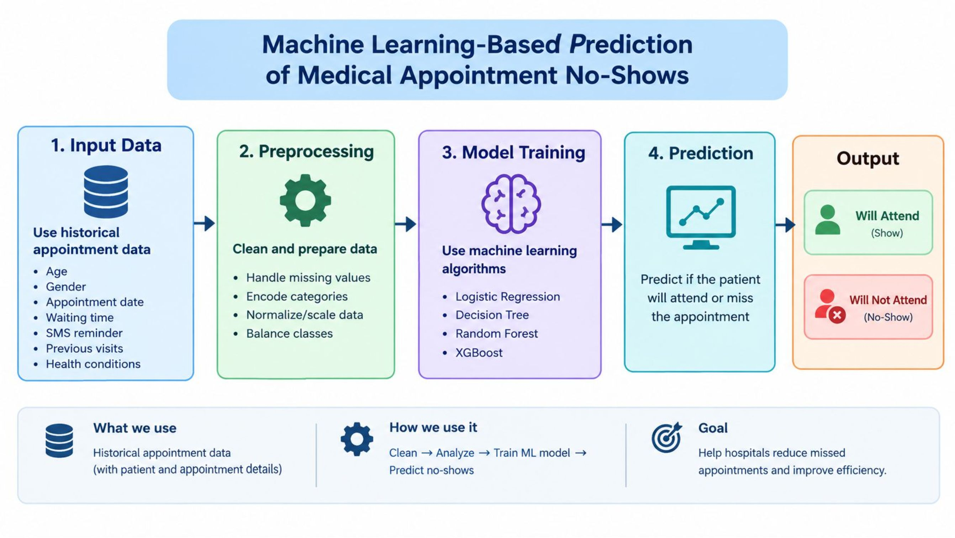
ARCHITECURE DIAGRAM

Slide 7
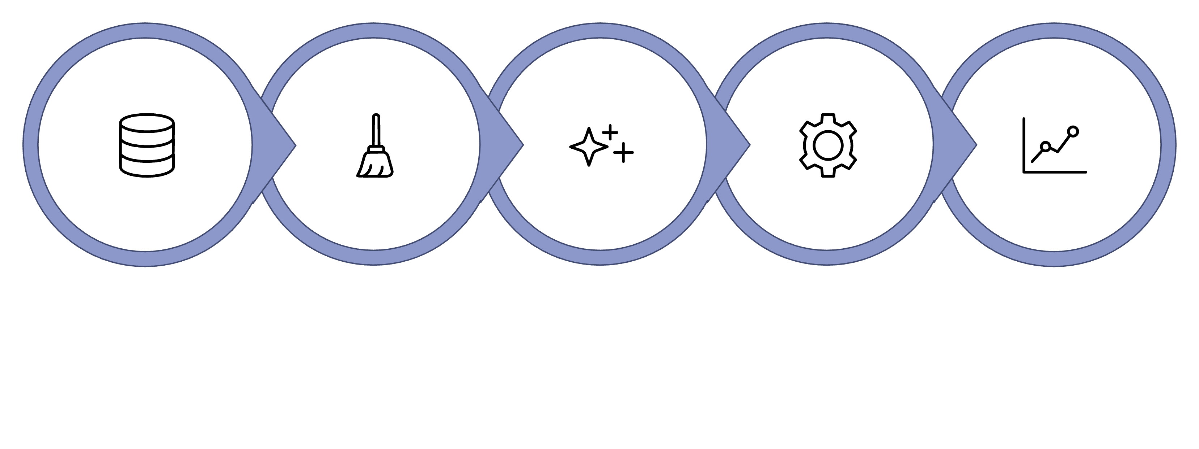
Data Collection
Feature Engineering
Model Training
Model Evaluation
Preprocessing
Pipeline: collect EMR & scheduling logs → clean and encode → engineer temporal and engagement features → train ML models → evaluate with held-out data → deploy risk scores to scheduling system.

Slide 8
ML Algorithms Compared
Logistic Regression
Decision Tree
Random Forest
XGBoost
Transparent decision paths; captures non-linear splits.
Ensemble that reduces variance; robust to noisy features.
Gradient boosting for strong predictive performance and feature importance ranking.
Baseline interpretable model; useful for odds ratios and explainability.

Slide 9
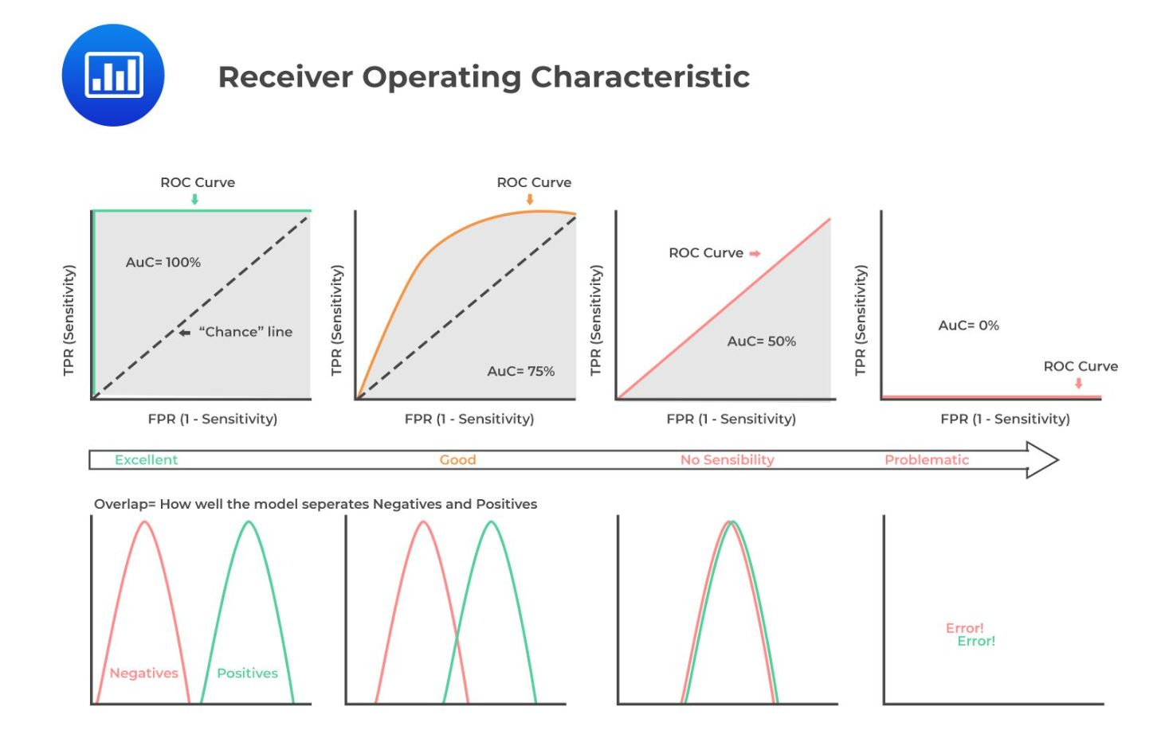
Evaluation Strategy
Metrics: Accuracy for overall correctness; Precision to limit unnecessary outreach; Recall to capture as many no-shows as possible; F1-score to balance precision/recall. Use stratified cross-validation to handle class imbalance.
Analysis tools: Confusion matrix to visualize trade-offs; ROC-AUC for ranking quality; calibration plots to ensure predicted probabilities map to real risks.

Slide 10

Expected Outcomes & Operational Impact
Early identification of high-risk appointments → focused reminders and outreach.
Reduced missed-appointment rates, improving clinic throughput and revenue capture.
Smarter scheduling: overbook or reassign slots where appropriate to maintain utilization.
Actionable feature insights (e.g., long wait times, prior no-shows) to guide policy changes.

Slide 11

Conclusion & Next Steps
Machine learning can reliably augment appointment management by predicting no-shows and enabling targeted operational responses. Next steps: finalize data access and governance, pilot models on a single clinic, monitor performance and clinician workflow impact, then scale with continuous monitoring and retraining.
Priority: Ensure patient privacy and clinical oversight when automating outreach.
Thank you — questions?

